Slide 1
NIFTY50 FORECAST
Delera Giacomo Howe Alessandro
Barbo Cyril
2024-2025

Slide 2
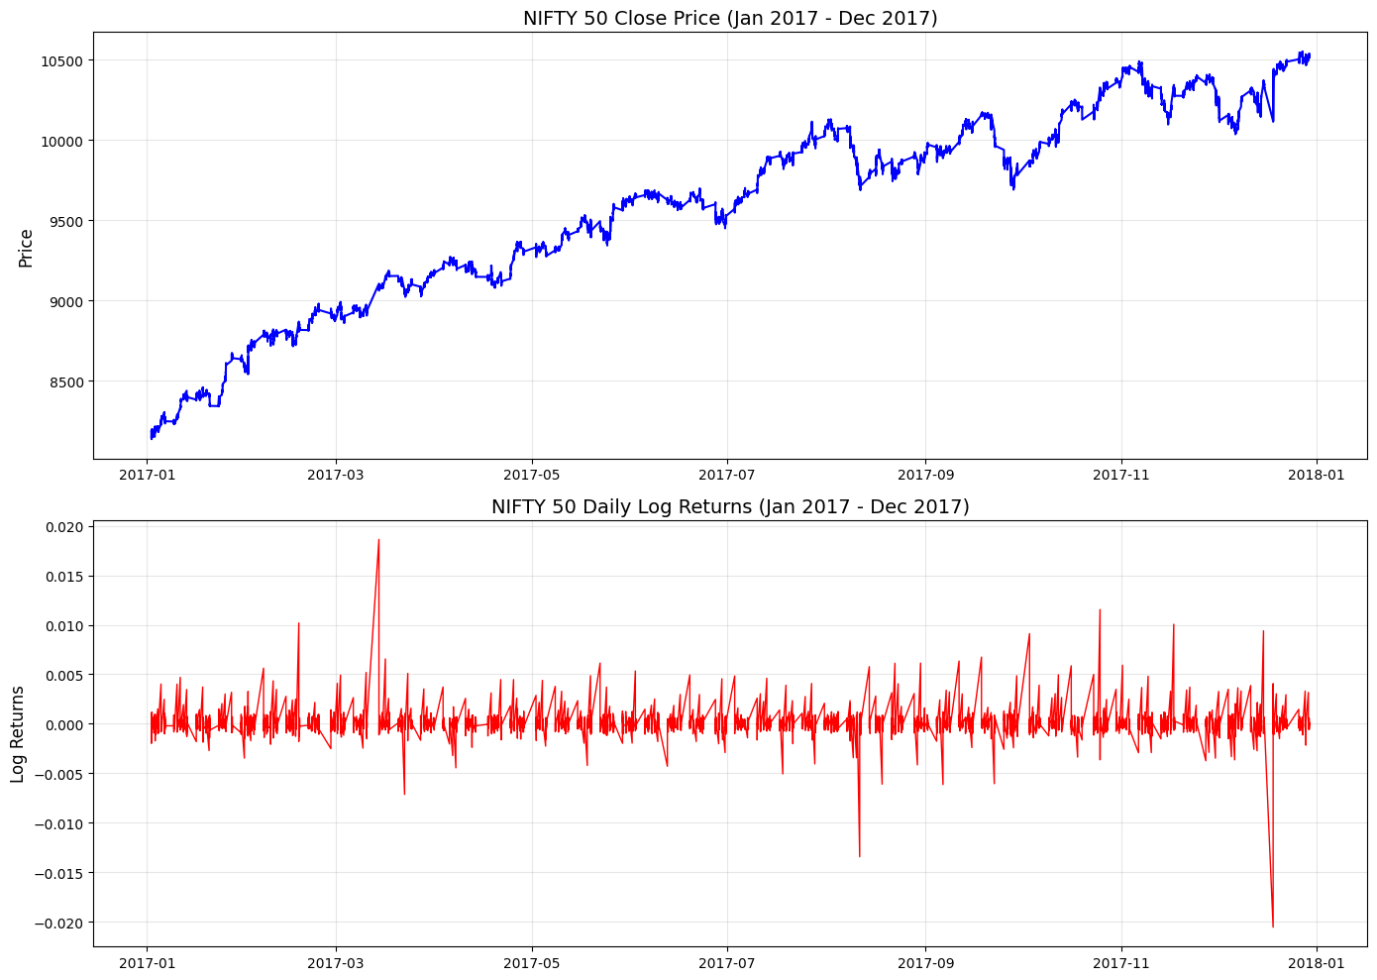
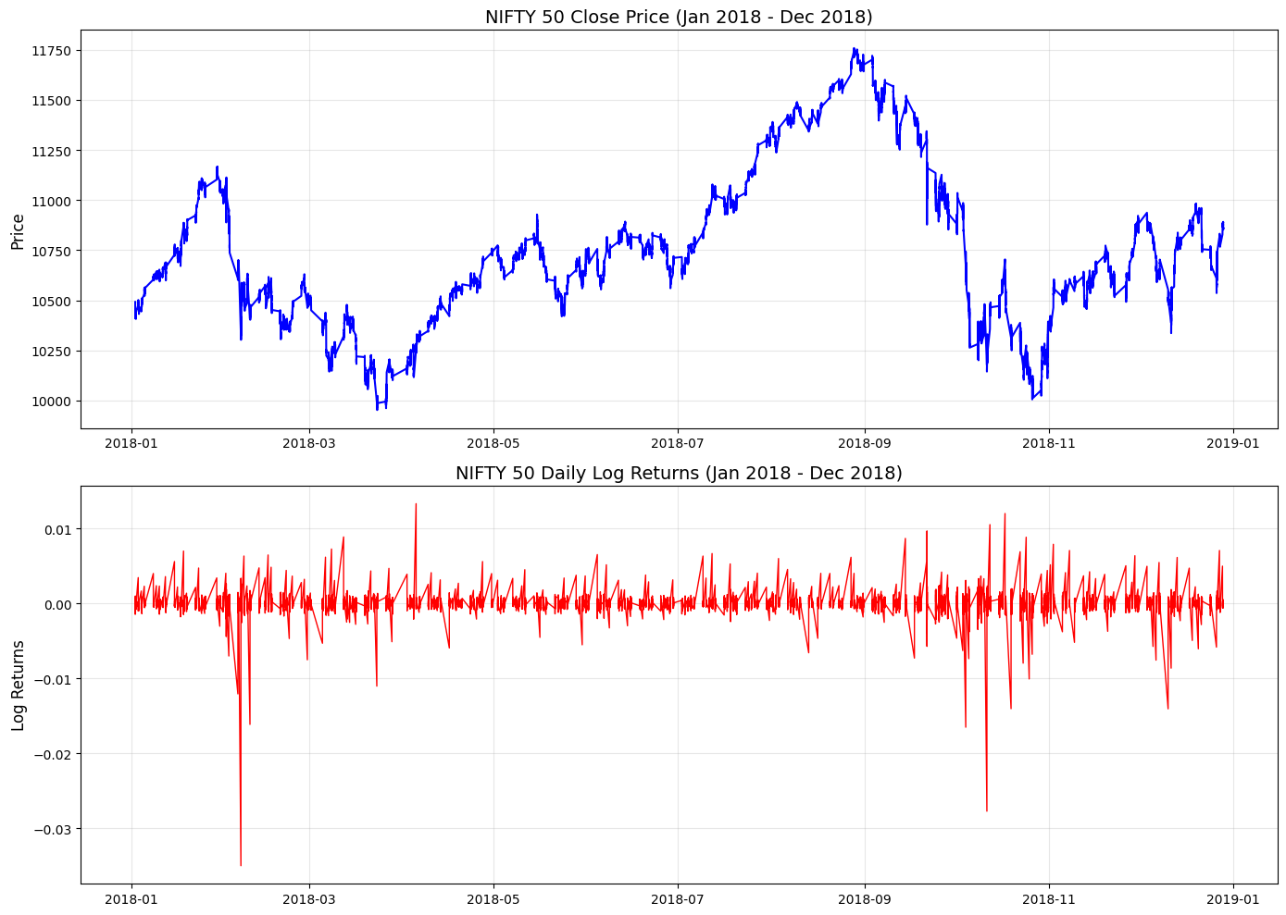
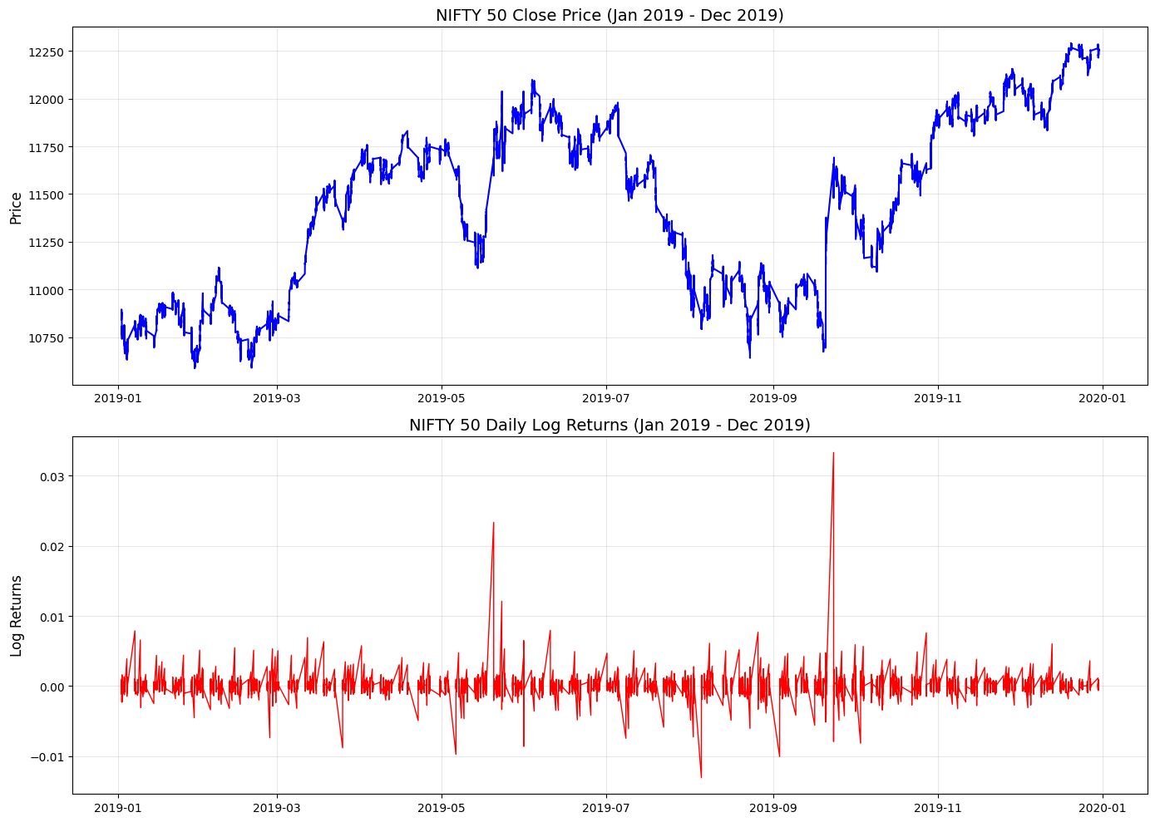
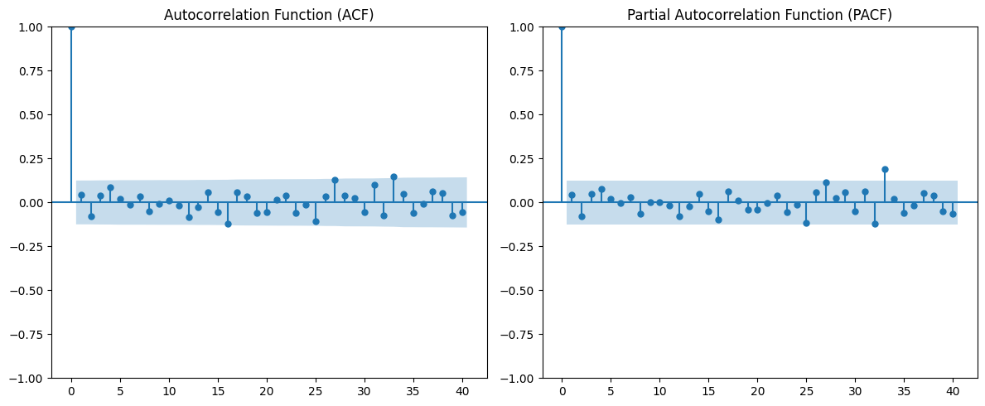
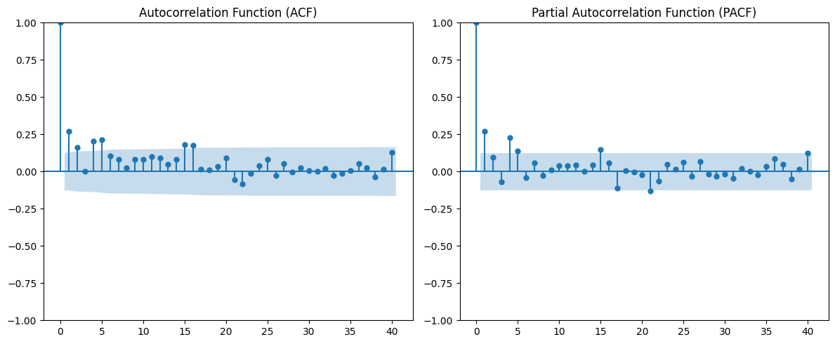
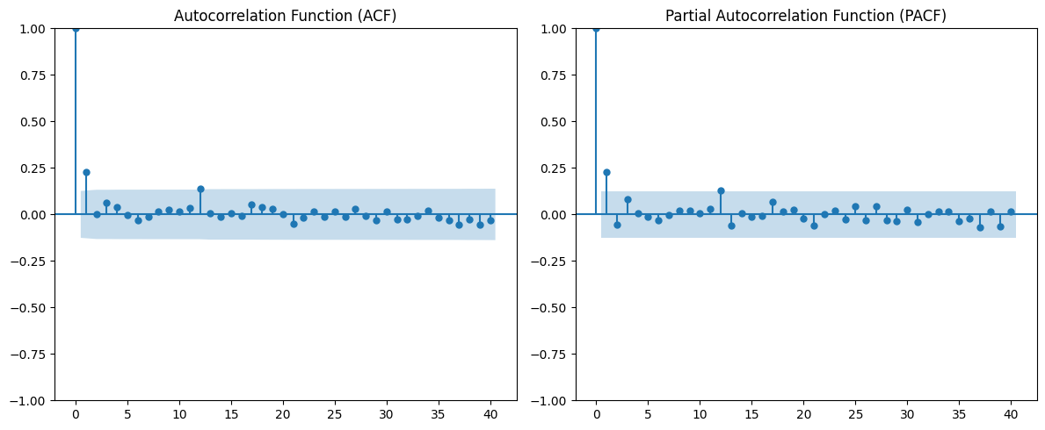
Dataset Description
Source: Historical NIFTY50 data from [Kaggle] Time Period: January 2017 – December 2022
Features: Date, Open, High, Low, Close prices, Volume traded Frequency: Minute observations
Daily returns
ADF tests (under all the 3 assumptions) show that there is statistical evidence to assume stationarity

Slide 3
Objective of the study
Main Goal: Forecasting of price and future volatility of the NIFTY50 index
Potential secondary goals:
Introduction of exogenous data for forecasting refinement
Approach:
Linear Regression and GARCH models for one step-ahead rolling window forecasting

Slide 4
Linear Models Forecast
Model: Linear regression and ARMA
Features Used: Previous day’s returns, lag values, moving averages
Result:
R² Score:
Residual Analysis indicates weak autocorrelation
Observation:
Good for capturing trend, Residuals not Guassian
immagine
immagine

Slide 5



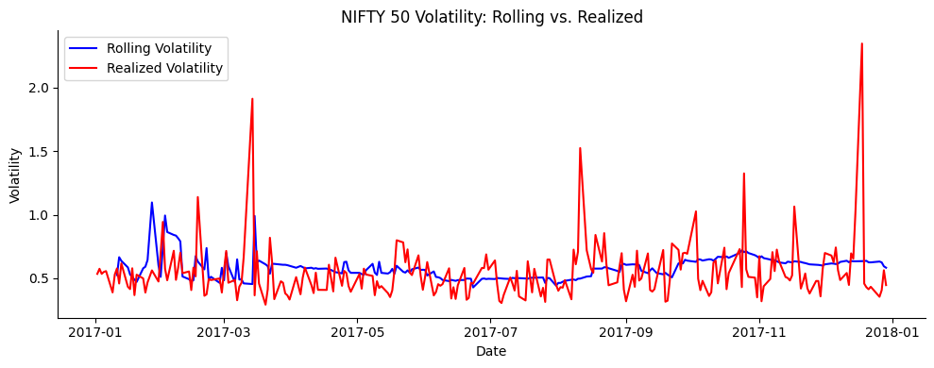
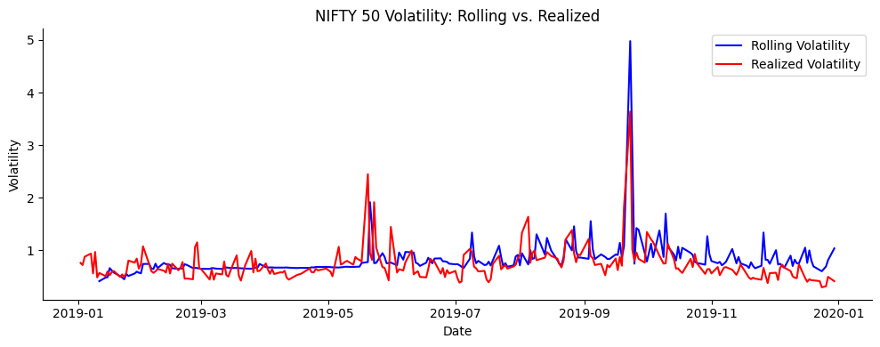
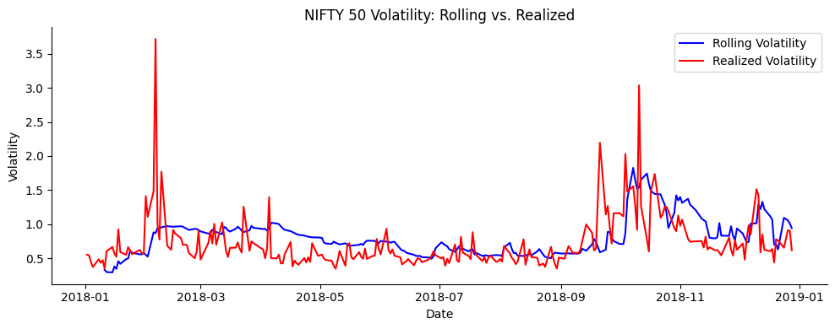
Modelling volatility with GARCH
Model: GARCH (Autoregressive Conditional Heteroskedasticity)
Purpose: Capture volatility clustering in financial time series
Result:
Significant ARCH effect (confirmed via LM test)
Low R^2 and adjusted R^2
Prediction: 1 step-ahead rolling window
R2=0.001
R2=0.102
R2=0.629

Slide 6
Correlation Analysis with Global Indices
Indices Analyzed: S&P 500, Dow Jones, Nikkei 225, FTSE 100
Method: Pearson Correlation of daily returns
Result:
Highest correlation: S&P 500 (e.g., 0.78)
Moderate correlation with Nikkei and FTSE
Implication: NIFTY50 is highly sensitive to U.S. market movements
immagine

Slide 7
Questions
Residuals not normal
Working with daily data
Working with a single index

